Slide 1
Prevention of contrast induced nephropathy
Evidence review
Dr. Sherief

Slide 2
Contrast induced nephropathy
Reversible (usually) form of AKI soon after administration of radiocontrast media
Non – DM : 13%
DM : 20%
Usually no permanent sequelae (Dialysis in 0.5% – 2.0%)
Associated with adverse outcomes
Aspelin P et al. Nephrotoxic effects in high-risk patients undergoing angiography. N Engl J Med 2003

Slide 3
CIN - Definition
KDIGO definition
CIN is defined when one of the following criteria is met
Serum creatinine rises by ≥ 0.3mg/dl within 48 hrs
Serum creatinine rises ≥ 1.5 fold from the baseline value
Urine output is < 0.5ml/kg/hr for >6 consecutive hrs
Trials : ≥0.5 mg/dL or ≥25 to 50% above baseline within 48-72 hrs

Slide 4
Predisposing factors
Baseline serum Creatinine
Acute MI
Shock / LVEF
Volume of contrast used
DM
Male gender
Incidence and prognostic importance of acute renal failure after percutaneous coronary intervention, circulation 2002
 | CIN | No CIN | p
In- hospital mortality | 22% | 1.4% | <0.0001
1 yr mortality | 12.1% | 3.7% | <0.0001
5 yr mortality | 44.6% | 14.5%

Slide 5
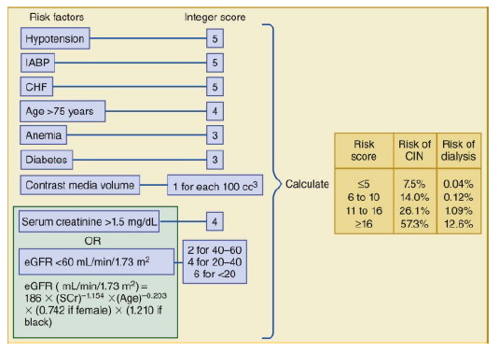
Mehran risk score

Slide 6
What the clinical trials evaluated?
End points : Small, transient elevations in the serum creatinine
? Dubious clinical significance
≥0.5 mg/dL or ≥25 to 50% above baseline
CIN defined in this manner is associated with significant in-hospital and long-term mortality
Rihal CS et al. Incidence and prognostic importance of acute renal failure after percutaneous coronary intervention. Circulation 2002
Dangas G et al. Contrast-induced nephropathy after percutaneous coronary interventions in relation to chronic kidney disease and hemodynamic variables. Am J Cardiol 2005

Slide 7
Prevention of CIN
No specific treatment once CI-AKI develops
Maintaining fluid and electrolyte balance

Slide 8
Preventive measures
Choice of contrast material : selected low or iso-osmolal nonionic contrast agents
Quantity of contrast : Use of lower doses of contrast
Avoidance of closely spaced repetitive studies (within 48 -72 hrs)
Avoidance of volume depletion/NSAIDs (increase renal vasoconstriction)
Hydration and volume expansion : iv saline or sodium bicarbonate
End organ protection with pharmacotherapy : Acetylcysteine / other agents

Slide 9
Role of contrast agents?

Slide 10
Contrast agents - Types
Types of radiocontrast agents
Iodinated radiocontrast agents
  Ionic or nonionic
  Variable osmolality
First generation agents
  Ionic monomers
  Highly hyperosmolal (1400 to 1800 mosmol/kg)
  Ioxaglate - ionic low osmolal contrast agent
Second generation agents
  Nonionic monomers (iohexol)
  Lower osmolality than the first generation agents
  Increased osmolality (500 to 850 mosmol/kg) compared with plasma

Slide 11
Contrast agents - Types
The newest nonionic contrast agents
  Iso-osmolal (lower osmolality than "low osmolal" second generation drugs)
  Dimers with an osmolality of 290 mosmol/kg
  Iodixanol is the first such agent
The nephrotoxic properties vary with the agents
CIN : non ionic low osmolal or iso-osmolal << High osmolal agents
The ionic low-osmolal agent ioxaglate - lower risk of contrast nephropathy
Lautin et al. Radiocontrast-associated renal dysfunction: a comparison of lower-osmolality and conventional high-osmolality contrast media. AJR Am J Roentgenol 1991

Slide 12
Nonionic low osmolal agents
Optimal renoprotective role of nonionic low osmolal contrast agents may vary with the clinical setting
Used for the majority of radiologic procedures using intravascular contrast media
  Cost reductions
  Increased patient tolerability
  Decreased hypersensitivity reactions
  Lower incidence of contrast nephropathy in patients at risk

Slide 13
Direct comparisons between the various agents
Which one to use?

Slide 14
Iohexol – superior to diatrizoate
Rudnick MR et al. Nephrotoxicity of ionic and nonionic contrast media in 1196 patients: a randomized trial. The Iohexol Cooperative Study. Kidney Int 1995
Prospective, multicenter, double-blind RCT
1200 patients undergoing CAG
Iohexol Vs Diatrizoate
Patients with a baseline creatinine >1.4 mg/dL
  Rise in the serum creatinine of ≥ 1.0 mg/dL (3% vs 7 %) P < 0.002
  Greater benefit in diabetics (11.8 vs 27%)

Slide 15
Iodixanol – superior to iohexol
Nonionic iso-osmolal agents
Iodixanol vs Iohexol
129 high risk patients undergoing CAG
DM and CKD (mean serum cr. 1.5 mg/dL)
CIN : 3 vs 26 % with iohexol p < 0.001
Aspelin P et al. Nephrotoxic effects in high-risk patients undergoing angiography. N Engl J Med 2003

Slide 16
Iso osmolal vs low osmolal
McCullough PA et al. A meta-analysis of the renal safety of isosmolar iodixanol compared with low-osmolar contrast media. J Am Coll Cardiol 2006
16 double-blind, RCT
n = 2,727
IOCM iodixanol vs LOCM
 |  | Iodixanol | LOCM | P
Maximum creatinine rise | Overall | 0.06 mg/dl | 0.10 mg/dl | p < 0.001
 | CKD | 0.07 mg/dl | 0.16 mg/dl | p = 0.004
 | CKD + DM | 0.10 mg/dl | 0.33 mg/dl | p = 0.003
CIN | Overall | 1.4% | 3.5% | p < 0.001
 | CKD | 2.8% | 8.4% | p = 0.001
 | CKD + DM | 3.5% | 15.5% | p = 0.003

Slide 17
Are iso osmolar agents superior to low osmolar agents?

Slide 18
Iodixanol = ioversol
VALOR Trial - 2008
Iodixanol vs ioversol
Prospective double blind trial
337 patients with stable CKD
CIN: 21.8% vs 23.8% (p=0.78) [> 0.5 mg/dl increase ≤ 72 hrs]
DM : Mean peak percentage change in creatinine was 12.9% vs 22.4% (p=0.01)
No significant difference in CIN in CKD pts undergoing angiography
Rudnick MR et al. Nephrotoxicity of iodixanol versus ioversol in patients with chronic kidney disease: the Visipaque Angiography/Interventions with Laboratory Outcomes in Renal Insufficiency (VALOR) Trial. Am Heart J 2008

Slide 19
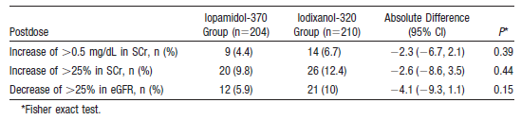
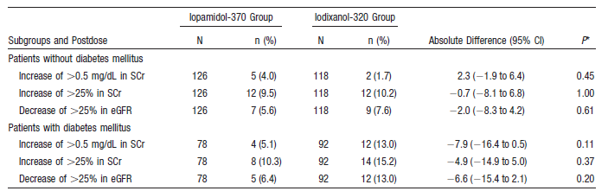
Iodixanol = iopamidol
Solomon RJ et al. Cardiac Angiography in Renally Impaired Patients (CARE) study: a randomized double-blind trial of contrast-induced nephropathy in patients with chronic kidney disease. Circulation 2007
Multicenter, double-blind RCT
CKD (eGFR 20 to 59 mL/min) who underwent CAG / PCI

Slide 20
Iodixanol = Iopamidol
Laskey W et al. Nephrotoxicity of iodixanol versus iopamidol in patients with chronic kidney disease and diabetes mellitus undergoing coronary angiographic procedures. Am Heart J 2009
Prospective multicenter double blind RCT
418 subjects
Iodixanol vs iopamidol
Median peak increase in SCr : 0.10 mg/dl vs 0.09 mg/dL (P =0.13)
CIN : 10.5%
  Iodixanol : 11.2%
  Iopamidol : 9.8% P = 0.7
No significant difference in either peak increase in SCr or risk of CIN

Slide 21
Solomon R. The role of osmolality in the incidence of contrast-induced nephropathy: a systematic review of angiographic contrast media in high risk patients. Kidney Int 2005
17 studies
1365 patients
CIN (overall) : 16.8%
Multivariate logistic regression
  CIN : Iodixanol = Iopamidol (796 mOsm/kg)
  Iodixanol << Iohexol
  Iopamidol << Iohexol (despite similar osmolalities)
Factors other than osmolality play a significant role in the pathogenesis of CIN

Slide 22
Reed M et al. The relative renal safety of iodixanol compared with low-osmolar contrast media: a meta-analysis of randomized controlled trials. JACC Cardiovasc Interv 2009
Meta-analysis
16 randomized trials
CKD patients
  Iodixanol vs Iohexol (RR 0.19, 95% CI 0.07-0.56)
  Iodixanol vs other nonionic low osmolal contrast agents (RR 0.79, 95% CI 0.56-1.12)

Slide 23
Summary
Iso-osmolal iodixanol vs low osmolal iohexol → iodixanol
Iodixanol vs nonionic low osmolal agents → No difference
Initial findings of superiority of iodixanol → Represents an adverse effect of iohexol

Slide 24
What the guidelines say?
ACC/AHA guidelines (2009) on PCI No to iohexol
Use of either an iso-osmolal contrast agent or a low osmolal contrast agent other than iohexol or the ionic low osmolal agent, ioxaglate
KDIGO guidelines (2012)
low-osmolal or iso-osmolal rather than high osmolal contrast agents
No reliable evidence upon which to base a recommendation for either low versus iso-osmolal agents

Slide 25
Which patients need selection of contrast agents?

Slide 26
Patients with renal insufficiency
Patients with moderate renal insufficiency (S.Cr 1.4 - 2.4 mg/dL) : Reduced incidence of CIN with nonionic, low osmolality agents
low vs high osmolal agents
 | CIN
Rudnik MR et al 1995 | 3% vs 7% p < 0.002
Lautin et al 1991 | 7% vs 26% p = 0.001
Moore RD et al 1992 | 2% vs 15% p < 0.05
Barrett BJ et al 1992 | 3.8% vs 6.8%
Harris KG et al 1991 | 2% vs 14% p < 0.05

Slide 27
Patients with normal renal function
RCT
1196 patients undergoing CAG
Patients were stratified into four groups:
  Renal insufficiency (RI)
  Diabetes mellitus (DM)
  Both absent (N = 364)
  RI -- ; DM + (N = 318)
  RI + ; DM -- (N = 298)
  RI and DM both present (N = 216)
Diatrizoate vs iohexol
Differences in nephrotoxicity between the two contrast groups were confined to patients with RI ± DM
Little or no advantage with low osmolar agents in normal renal function
Rudnick MR et al. Nephrotoxicity of ionic and nonionic contrast media in 1196 patients: a randomized trial. The Iohexol Cooperative Study. Kidney Int 1995

Slide 28
How much (contrast) to use?

Slide 29
Contrast volume
The prevalence of CIN correlates with contrast volume
Lowest rates of CIN occur in patients receiving < 100 to 140 mL
Volumes > 5mL/kg strongly predict nephropathy requiring dialysis
Freeman RV et al. Nephropathy requiring dialysis after percutaneous coronary intervention and the critical role of an adjusted contrast dose. Am J Cardiol 2002
Second dose of contrast ≤ 48 hrs → significantly increased risk of CIN
Trivedi H, Foley WD. Contrast-induced nephropathy after a second contrast exposure. Ren Fail 2010
Independent predictors of CIN
  LVEF (P = 0.02)
  Contrast volume (P = 0.01)
Gruberg L et al. The prognostic implications of further renal function deterioration within 48 h of interventional coronary procedures in patients with pre-existent chronic renal insufficiency. J Am Coll Cardiol 2000
The primary benefit of nonionic contrast agents (LOCM/IOCM) is seen in high-risk patients (S.Cr ≥1.5 mg/dL or GFR <60 mL/min/1.73 m²), particularly in diabetics

Slide 30
Carbon dioxide : An alternative contrast agent
Used alone or with small amounts of iodinated contrast
Satisfactory imaging and procedural results with modern imaging technology (DSA) (Schreier DZ et al. Arch Surg 1996)
No or little nephrotoxicity, cheap, non-allergenic
Risk of neurotoxicity
  Injected close to the cerebral circulation
  Right-to-left intracardiac shunt
  Cannot be used for cerebrovascular imaging
Limited to imaging below the diaphragm

Slide 31
Volume administration, mannitol and diuretics

Slide 32
Diuretics
Solomon R et al. Effects of saline, mannitol, and furosemide to prevent acute decreases in renal function induced by radiocontrast agents. N Engl J Med 1994
78 patients
Stable CKD (mean cr. 2.1 mg/dL ) awaiting CAG
Randomly assigned to one of three regimens
  0.45% saline at a rate of 1 mL/kg/hr for 12 hrs before and 12 hrs after CAG
  0.45% saline + 25 g of iv mannitol (1 hr before procedure)
  0.45% saline + 80 mg of iv furosemide (30 mins before CAG)
AKI : rise in the serum creatinine of ≥ 0.5 mg/dL
AKI :
  Lowest in the group treated with saline alone
  Mannitol was of no added benefit
  Furosemide therapy slightly increased the risk (despite absence of volume depletion)

Slide 33
Saline : superior to dopamine, mannitol
Weisberg LS et al. Risk of radiocontrast nephropathy in patients with and without diabetes mellitus. Kidney Int 1994
50 patients (24 diabetics)
Moderate CKD (mean creatinine 2.5 mg/dL ) awaiting CAG
Randomly assigned to receive
  Saline
  Dopamine [2 mcg/kg/min]
  Mannitol [15 g/dL in 0.45% saline at 100 mL/h]
  ANP
CIN : 25 % increase in S.Cr

Slide 34
Saline : superior to dopamine, mannitol
Results :
  Saline hydration: 40 % incidence of renal dysfunction in DM and non-DM patients
  Dopamine, mannitol and ANP :
    75 to 83% in diabetics
    Nondiabetic patients : No cases of contrast toxicity
Mannitol - associated with significant complications

Slide 35
Forced euvolemic diuresis : harmful
Majumdar SR et al. Forced euvolemic diuresis with mannitol and furosemide for prevention of contrast-induced nephropathy in patients with CKD undergoing coronary angiography: a randomized controlled trial. Am J Kidney Dis 2009
RCT
92 patients
Moderate renal insufficiency (mean S.Cr 2.8 mg/dL )
Mannitol + furosemide vs placebo
500 ml 0.45% saline + 25g mannitol + 100mg frusemide
AKI : 25% increase in S.Cr
Result :
  50% vs 28% p = 0.03
  OR 3.73, 95% CI 1.12-12.38
There was no difference in net fluid balance between the groups

Slide 36
RenalGuard system
Fluid management device
Minimize the risk of volume depletion in the setting of a forced diuresis (Briguori C et al. (REMEDIAL II) EuroIntervention 2011)

Slide 37
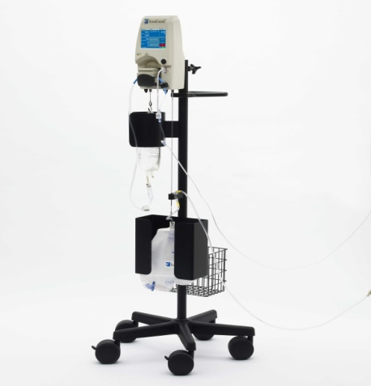
REMEDIAL II
Briguori C et al. Renal Insufficiency After Contrast Media Administration Trial II (REMEDIAL II): RenalGuard System in high-risk patients for contrast-induced acute kidney injury. Circulation 2011
Multicenter RCT
292 patients
eGFR ≤ 30 ml/min/1.73m²
RenalGuard group : Hydration with saline and NAC controlled by RenalGuard system and frusemide
Control : NaHCO₃ and NAC
CIN : 11% vs 20.5%
OR 0.47 95% CI 0.24 – 0.92

Slide 38
MYTHOS trial
Marenzi G et al. Prevention of contrast nephropathy by furosemide with matched hydration: the MYTHOS (Induced Diuresis With Matched Hydration Compared to Standard Hydration for Contrast Induced Nephropathy Prevention) trial. JACC Cardiovasc Interv 2012
170 patients
CKD
Furosemide with matched hydration vs standard iv saline hydration
250 ml iv saline followed by 0.5mg/kg of furosemide
CIN : 4.6% vs 18% p = 0.005

Slide 39
Disadvantages of forced diuresis
Concerns about high volume forced diuresis (even in the setting of carefully matched volume replacement)
  volume overload may ensue if isotonic saline is used to replace urine
  Urine generally has the tonicity of half normal saline following loop diuretics
  Increase in intravascular volume may increase the eGFR in patients undergoing forced diuresis
Hypokalemia from forced diuresis may precipitate arrhythmia in a vulnerable population

Slide 40
Isotonic vs half normal saline

Slide 41
Isotonic vs half normal saline
The optimal iv solution (isotonic saline, 0.45% saline or isotonic NaHCO₃) for prevention of CIN is unclear
Isotonic saline was superior to 0.45% saline (Weisbord SD et al Clin J Am Soc Nephrol 2008)
Mueller C et al. Prevention of contrast media-associated nephropathy: randomized comparison of 2 hydration regimens in 1620 patients undergoing coronary angioplasty. Arch Intern Med 2002
RCT
1620 patients
Isotonic vs 0.45% saline (1 mL/kg/hr from the morning of the procedure and continued until 8 AM the next morning)
Baseline S.Cr : 0.9 mg/dL in both groups

Slide 42
Isotonic vs half normal saline
CIN : ↑in S.Cr of ≥ 0.5 mg/dL within 48 hrs
The overall incidence of CIN was 1.4%
Significantly lower with isotonic saline (0.7 vs 2.0%)
  More pronounced benefit
    Diabetic patients (0 versus 5.5%)
    Use of > 250 mL of contrast (0 versus 3%)
No difference for those with significant renal dysfunction (s.cr. >1.6 mg/dL)
  Saline : 14%
  0.45% saline : 17%
  Important limitation : patients with underlying renal dysfunction are at increased risk for CIN

Slide 43
Saline vs Bicarbonate

Slide 44
Saline – superior to bicarbonate
Trivedi HS et al. A randomized prospective trial to assess the role of saline hydration on the development of contrast nephrotoxicity. Nephron Clin Pract 2003
RCT
Prolonged infusion of isotonic saline vs briefer infusions of isotonic NaHCO₃
Saline : 1 mL/kg/h for at least 12 hrs prior to and after the procedure
NaHCO₃ : 3 mL/kg for 1 hr prior to and 1 mL/kg/h for 6 hrs after the procedure
Lower rate of CIN with isotonic saline

Slide 45
Saline – superior to bicarbonate
koc F et al. Sodium bicarbonate versus isotonic saline for the prevention of contrast-induced nephropathy in patients with diabetes mellitus undergoing coronary angiography and/or intervention: a multicenter prospective randomized study. J Investig Med 2013
RCT
195 DM patients
 |  | Saline | Bicarbonate | p
Max. ↑ in S.Cr | Overall | - 0.03 | 0.02 | 0.014
 | Cr.Cl <60 | - 0.08 | 0.03 | 0.004
CIN |  | 5.9% | 16% | 0.024

Slide 46
Bicarbonate : superior to saline
Trial |  | No. | Agents used | CIN
Merten GJ et al JAMA 2004 | RCT | 119 | NaCl vs NaHCO₃ | 1.7% vs 13.6% P = 0.02
Briguori C et al REMEDIAL Trial Circulation 2007 | RCT | 326 | NaHCO₃ + NAC NaCl + NAC | 1.9% vs 9.9% P = 0.019
Recio-Mayoral A et al RENO Study JACC 2007 | RCT | 111 ACS pts | NaHCO₃ + NAC NaCl | 1.8% vs 21.8% P < 0.001
Ozcan EE et al Am Heart J 2007 | RCT | 264 | NaHCO₃ NaCl NaCl + NAC | P<0.007 (1 vs 2,3) P=0.03 (1 vs 2) P=0.05 (1 vs 3)

Slide 47
Bicarbonate : Non-inferior to saline
Brar SS et al. JAMA 2008
Maioli M et al. J Am Coll Cardiol 2008
Alonso A et al. Am J Kidney Dis 2004
Vasheghani-Farahani A et al. Am J Kidney Dis 2009
Brar SS et al. Clin J Am Soc Nephrol 2009

Slide 48
Oral hydration (no salt)
Increasing number of individuals receive contrast as outpatients
3 small trials have evaluated the effectiveness of oral hydration or salt loading in preventing contrast nephropathy
Trivedi HS et al. A randomized prospective trial to assess the role of saline hydration on the development of contrast nephrotoxicity. Nephron Clin Pract 2003
53 patients
Unrestricted oral fluids (no salt) vs normal saline at 1 mL/kg/hr for 24 hrs beginning 12 hrs prior to the procedure
AKI : 35% vs 4%

Slide 49
Salt loading
The two trials that included salt loading as part of the protocol showed no difference in outcome compared to intravenous saline:
Taylor AJ et al. PREPARED: Preparation for Angiography in Renal Dysfunction: a randomized trial of inpatient vs outpatient hydration protocols for cardiac catheterization in mild-to-moderate renal dysfunction. Chest 1998
36 patients
Serum creatinine ≥1.4 mg/dL
Outpatient oral hydration followed by 6 hrs of iv 0.45% saline vs inpatient regimen of iv 0.45% saline
No difference in the maximal change in creatinine between the two groups

Slide 50
Oral salt loading = iv saline
Dussol B, Morange S, Loundoun A, et al. A randomized trial of saline hydration to prevent contrast nephropathy in chronic renal failure patients. Nephrol Dial Transplant 2006
153 patients
CKD (mean S.Cr 2.2 mg/dL )
Salt loading with tablets vs iv saline
Salt loading : 1 g/10 kg/day in 3 doses for 2 days before contrast
Saline : 15 mL/kg for 6 hrs
No difference in the incidence of CIN
Safety and efficacy of oral hydration or salt loading for the prevention of contrast nephropathy remains uncertain

Slide 51
Summary
Prophylactic diuretics or mannitol - not beneficial
Before fluid loading, consider the patient's ability to tolerate the fluid load (LV function), the ability to tolerate alkalinization
The optimal type of fluid and timing are not well established
iv volume administration is superior to oral hydration
Oral hydration with water alone should not be used
iv isotonic saline : superior to 0.45% saline
Isotonic NaHCO₃ may be superior to isotonic saline

Slide 52
Summary
NaHCO₃ regimen : 3 mL/kg bolus of isotonic NaHCO₃ for 1 hr prior and continued at 1 mL/kg/hr for 6 hrs after the procedure
Currently, no commercially available isotonic NaHCO₃ available
Isotonic NaHCO₃ can be prepared by adding 150 mEq of NaHCO₃(three 50 mL ampules of 1 mEq/mL) to 850 mL of sterile water
2012 KDIGO guideline Work Group (Kidney Int Suppl 2012)
  No specific recommendation for the use of NaHCO₃ preferentially to saline
  Potential harm from errors in compounding of the bicarbonate solutions at point of care or in the hospital pharmacy

Slide 53
Role of acetyl cysteine

Slide 54
Acetylcysteine
A thiol compound with antioxidant and vasodilatory properties
Possible mechanism of benefit
  ↓ vasoconstriction
  ↓ oxygen free radical generation
Great heterogeneity and conflicting results in the available clinical trials and meta-analyses
Factors contributing to the inconsistent results
  Definition of CIN
  Baseline risk for AKI (DM, CKD)
  Dose and route of administration (eg, oral or iv)
  iv volume administration protocols
  Amount and type of contrast given
  Type of procedure performed (eg, contrast CT, cardiac catheterization or peripheral angiography)

Slide 55
ACT trial
Acetylcysteine for the prevention of Contrast-induced Nephropathy
  2308 patients undergoing angiography
  ≥1 of the risk factors:
    > 70 years, CKD, DM, HF or LVEF < 45% or shock
  NAC (1200 mg orally BD) vs placebo on the day before and after angiogram
  AKI definition : ≥ 25% increase in serum creatinine within 48 to 96 hrs
  AKI : 12.7% in both groups
  No difference in secondary endpoints (death, need for dialysis at 30 days)
ACT Investigators. Acetylcysteine for prevention of renal outcomes in patients undergoing coronary and peripheral vascular angiography: main results from the randomized Acetylcysteine for Contrast-induced nephropathy Trial (ACT). Circulation 2011

Slide 56
ACT trial
Subgroup analysis : No difference between groups
Patients with CKD [serum cr. ≥ 1.5 mg/dL]
  n = 367
  6.4 vs 5.6 %
Patients with stage 3 CKD [eGFR 30 - 60 mL/min per 1.73m²]
  n = 823
  7.1 vs 6.8%
Patients with stage 4 CKD [eGFR <30 mL/min per 1.73m²]
  n = 104
  10.7 vs 6.3%
Patients with DM

Slide 57
NAC : Meta analysis
 | No. RCT | No. patients | Beneficial
Alonso A et al Am J Kidney Dis 2004 | 8 | 885 | yes
Birck R et al. Lancet 2003 | 7 | 805 | yes
Pannu N et al. Kidney Int 2004 | 15 | 1776 | P = 0.049
Liu R et al. J Gen Intern Med 2005 | 9 | 1028 | yes
Nallamothu BK et al. Am J Med 2004 | 20 | 2195 | ?yes
Zagler A et al. Am Heart J 2006 | 13 | 1892 | Not conclusive
Kelly AM et al. Ann Intern Med 2008 | 41 |  | yes
Gonzales DA et al. BMC Med 2007 | 22 | 2746 | No

Slide 58
Low vs high dose of acetyl cysteine

Slide 59
NAC : Dosing
600 mg orally BD - most commonly studied dose
  Risk ratio of 0.73 (95% CI 0.46-1.2) - subgroup analysis of 12 studies
  (Nallamothu BK et al , Am J Med 2004)
600 mg vs 1200 mg BD - slightly better outcomes with the higher dose (Briguori C et al. Eur Heart J 2004)
Meta-analysis of 1677 subjects
High dose NAC (> 600 mg) vs control
>70 % had CKD at baseline
The risk of CIN : Odds ratio 0.46 (95% CI 0.33-0.64)
Preferred dose: 1200 mg orally BD on the day before and the day of the procedure
Trivedi H et al. High-dose N-acetylcysteine for the prevention of contrast-induced nephropathy. Am J Med 2009

Slide 60
RAPPID study – iv NAC
Baker CS et al. A rapid protocol for the prevention of contrast-induced renal dysfunction: the RAPPID study. J Am Coll Cardiol 2003
80 patients
Mean baseline creatinine of 1.8 mg/dl
iv NAC vs isotonic saline
NAC : 150 mg/kg pre procedure followed by 50 mg/kg over 4 hrs post procedure
Normal saline : 1 ml/kg/hr for 12 hrs pre- and post-contrast
Result : 5 vs 20% P = 0.004
At the high doses used, 7 % developed anaphylactoid reactions

Slide 61
Marenzi G et al. N-acetylcysteine and contrast-induced nephropathy in primary angioplasty. N Engl J Med 2006
354 patients with AMI
iv NAC 1200mg vs 600mg vs control
iv NAC bolus was followed by the same oral dose BD for 2 days
AKI definition : ≥25 % increase in S.Cr
Result : 8 vs 15 vs 33 % p < 0.001
Drawbacks
Most patients had normal kidney function (baseline S.Cr 1.0 mg/dL)
A large proportion of the control group had severe complications that could explain the AKI (eg, IABP, mechanical ventilation)

Slide 62
iv NAC – no benefit
Webb JG et al. A randomized controlled trial of intravenous N-acetylcysteine for the prevention of contrast-induced nephropathy after cardiac catheterization: lack of effect. Am Heart J 2004
RCT
487 patients
Mean baseline serum creatinine of 1.6 mg/dl
All received isotonic saline (200 mL before the procedure, 1.5 mL/kg/hr for 6 hrs after)
No benefit with iv acetylcysteine (500 mg immediately before the procedure)
Lack of convincing evidence of benefit
Potential risk of anaphylactoid reactions
Routine use of iv NAC for the prevention of CIN is not advocated

Slide 63
Acetyl cysteine
  Potentially beneficial
  Well tolerated
  Relatively inexpensive
2012 KDIGO guidelines
  Administration of acetylcysteine to high risk patients
  Must be accompanied by iv isotonic fluid and use of a low or iso-osmolal contrast agent

Slide 64
Prophylactic hemofiltration and hemodialysis

Slide 65
Prophylactic hemofiltration and hemodialysis
Marenzi G et al. The prevention of radiocontrast-agent-induced nephropathy by hemofiltration. N Engl J Med 2003
114 patients
Mean S.Cr of 3.0 mg/dL
Isotonic saline infusion (1 mL/kg/hr) vs hemofiltration (1000 mL/hr fluid replacement rate)
4-8 hrs prior to the procedure and 18 - 24 hrs after the procedure
250 mL of a nonionic, low-osmolality contrast
CIN : 5 vs 50 % for saline p < 0.001
Requirement for dialysis : 3 vs 25%

Slide 66
Prophylactic hemofiltration and hemodialysis
Marenzi G et al. Comparison of two hemofiltration protocols for prevention of contrast-induced nephropathy in high-risk patients. Am J Med 2006
92 patients
CKD (creatinine clearance ≤ 30 mL/min)
3 different prophylactic treatments:
  control group : Isotonic saline (1 mL /kg/hr X 12 hrs before and after contrast
  post-hemofiltration group : iv hydration for 12 hrs before contrast, followed by hemofiltration for 18 - 24 hrs after contrast
  pre/post-hemofiltration group : Hemofiltration for 6 hrs before and for 18 - 24 hrs after contrast
 | control | post-hemofiltration | pre/post-hemofiltration | P value
CIN | 40% | 26% | 3% | P = 0.0013
Requirement of HD | 30% | 10% | 0% | P = 0.002

Slide 67
Drawbacks
The reported benefits – real benefits?
  study design flaws
  unusual clinical features
Hemofiltration → removes creatinine → ↓ frequency of creatinine elevation
HD was started for oligoanuria for ≥ 48 hrs
  oligoanuria alone – not an indication for RRT in usual clinical practice (spontaneous resolution of CIN within a few days is common)
  Artificially increased the proportion dialyzed in the saline group
Hemofiltration group received bicarbonate-containing replacement fluid → protective effect

Slide 68
Hemofiltration and HD : Meta analysis
Cruz DN et al. Renal replacement therapies for prevention of radiocontrast-induced nephropathy: a systematic review. Am J Med 2012
Meta-analysis
8 studies of HD and 3 studies of hemofiltration (9 RCT)
1010 patients
CIN :
  RRT group : 23.3%
  Med. Therapy : 21.2% RR 1.02; 95% CI 0.54-1.93
HD increased CIN risk (RR 1.61; 95% CI, 1.13-2.28)
No effect on need for permanent RRT or progression to ESRD RR 1.47; 95% CI, 0.56-3.89
Periprocedural RRT did not decrease the incidence of CIN compared with SMT

Slide 69
Hemodialysis
Cruz DN et al. Extracorporeal blood purification therapies for prevention of radiocontrast-induced nephropathy: a systematic review. Am J Kidney Dis 2006
Meta-analysis
8 studies (6 RCT)
412 patients
Mean baseline S.Cr from 2.5 to 4.0 mg/dl
CIN :
  Medical-therapy group : 35.2%
  Extracorporeal-blood-purification group : 27.8%
  (RR 0.97; 95% CI 0.44 to 2.14)
No benefit and a possible harm with HD

Slide 70
Lee PT et al. Renal protection for coronary angiography in advanced renal failure patients by prophylactic hemodialysis. A randomized controlled trial. J Am Coll Cardiol 2007
82 patients
Baseline S.Cr of 4.9 mg/dL or creatinine clearance of <15 mL/min/1.73 m²
HD (≤12 hrs of CAG) vs no HD
 | HD | No HD | p
Day 4 creatinine | 5.1 mg/dl | 6.3 mg/dl | 0.010
Peak cr. | 5.3 mg/dl | 6.7 mg/dl | 0.005
Temporary RRT | 2% | 35% | < 0.001
Long-term dialysis | 0 | 13% | 0.018
Discharge cr. >1mg/dl | 5% | 37% | < 0.001
Possible benefit from prophylactic HD in patients with substantially more severe renal disease

Slide 71
What the evidence says
Hemofiltration
Expensive
Cumbersome
Significant risks
Effectiveness compared to other less expensive strategies is not well established
Reported benefits are implausible

Slide 72
Inhibition of renal vasoconstriction
Theophylline or aminophylline (inhibition of the effect of adenosine)
(Ix JH et al. Nephrol Dial Transplant 2004)
Nifedipine
Captopril
Prostaglandin E or I2 (Spargias K et al. Circulation 2009)
Low-dose dopamine
Fenoldopam (Chamsuddin AA et al. AJR Am J Roentgenol 2002)

Slide 73
Theophylline
Dai B et al. Effect of theophylline on prevention of contrast-induced acute kidney injury: a meta-analysis of randomized controlled trials. Am J Kidney Dis 2012
Meta-analysis
13 studies
1222 patients
Theophylline : ↓ risk for CIN but not for dialysis
McCullough PA et al. Theophylline or aminophylline for the prevention of contrast-induced acute kidney injury. Am J Kidney Dis 2012
Analysis of all studies : Theophylline was not protective among high-risk patients
Analysis of only higher quality studies : Theophylline was not beneficial in any group of patients

Slide 74
Iloprost
Spargias K et al. Iloprost prevents contrast-induced nephropathy in patients with renal dysfunction undergoing coronary angiography or intervention. Circulation 2009
RCT
208 patients undergoing CAG
S.Cr > 1.4 mg/dL
iv Iloprost vs placebo
Iloprost : 1 ng/kg/min ; 30 mins before and 4 hrs after
CIN : 8% vs 22% OR 0.29; 95% CI 0.12 to 0.69; P=0.005
Severe hypotension required withdrawal of Iloprost in 3 patients
Insufficient data to support routine use

Slide 75
Fenoldopam
Kini AS et al. A protocol for prevention of radiographic contrast nephropathy during percutaneous coronary intervention: effect of selective dopamine receptor agonist fenoldopam. Catheter Cadiovasc Intervent 2002
150 patients
IV fenoldopam vs hydration only
CIN :
  4.7% vs 18.8% P <0 .001
Clinically significant hypotension

Slide 76
Fenoldopam : no benefit
Stone GW et al. Fenoldopam mesylate for the prevention of contrast-induced nephropathy: a randomized controlled trial. JAMA 2003
CONTRAST study
Prospective RCT
315 patients (50% diabetic)
CKD (mean eGFR 29 mL/min; mean creatinine of 1.8 mg/dL)
All patients received 0.45% saline
iv fenoldopam (0.05 microg/kg/min) vs placebo
CIN : 34 vs 30% RR 1.11; 95% CI 0.79-1.57; P =0.61
Dialysis : 2.6% vs 1.9%, P =0.72

Slide 77
Targeted renal therapy
Direct delivery of medications to the kidneys via the renal arteries
TRT
  Improves the therapeutic window
  Increases intrarenal drug concentration
  Reduces systemic effects
The Benephit Infusion Catheter
  Bifurcated infusion catheter that allows TRT during coronary or peripheral catheterization
TRT vs IV fenoldopam
↓plasma drug concentration
↑GFR (+25% vs – 14%)
↑ BP
Teirstein PS et al. Differential effects between intravenous and targeted renal delivery of fenoldopam on renal function and blood pressure in patients undergoing cardiac catheterization. Am J Cardiol 2006

Slide 78
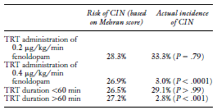
Fenoldopam : TRT
The Benephit System Renal Infusion Therapy (Be–RITe!) Multicenter Registry
501 high risk patients were enrolled
285 patients received TRT with fenoldopam
CIN was 71% lower than predicted
Weisz G et al. Safety and performance of targeted renal therapy: the Be–RITe! Registry. J Endovasc Ther 2009

Slide 79

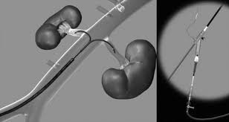
The Benephit Infusion Catheter

Slide 80
Endothelin antagonist : Harmful
Wang A et al. Exacerbation of radiocontrast nephrotoxicity by endothelin receptor antagonism. Kidney Int 2000
Multicenter, double-blind RCT
158 high-risk patients undergoing CAG
Mean S.Cr : 2.7mg/dl
A nonselective endothelin receptor antagonist (SB 209670) vs placebo
CIN : 56% vs 29% P = 0.002
Mean increase in S.Cr at 48 hrs
  0.7 ± 0. 7 mg/dL 0.4 ± 0.6 mg/dL P = 0.002
More events of hypotension

Slide 81
Other interventions
Remote ischemic preconditioning (RIPC)
Atrial natriuretic peptide
Statins
Ascorbic acid

Slide 82
Remote ischemic preconditioning : RenPro trial
Er F et al. Ischemic preconditioning for prevention of contrast medium-induced nephropathy: randomized pilot RenPro Trial (Renal Protection Trial). Circulation 2012
Double blind RCT
100 patients undergoing elective CAG
Baseline S.Cr >1.4 mg/dL or eGFR <60 mL/min /1.73m²
RIPC : 4 cycles of 5 minute inflation of a BP cuff to 50 mm Hg above individual systolic pressure within 45 mins before CAG
The sham procedure : Inflation of a BP cuff to individual DBP followed by deflation to 10 mmHg
All patients received NAC and a continuous saline infusion
CIN (≥25% or ≥0.5 mg/dL )
  6 vs 20% p = 0.03
  OR 0.21, 95% CI 0.07 – 0.57

Slide 83
Atrial natriuretic peptide : No benefit
Anaritide - Beneficial in animal models of contrast nephropathy
Kurnik BR et al. Prospective study of atrial natriuretic peptide for the prevention of radiocontrast-induced nephropathy. Am J Kidney Dis 1998
Prospective, multicenter, double-blind, placebo-controlled RCT
247 patients
Serum creatinine > 1.5 mg/dl
Placebo vs one of three iv doses of anaritide
30 mins before and continued for 30 mins after the procedure
No benefit was observed at any dose in all patient groups

Slide 84
Statins to prevent CIN
 | Study type | No. of pts | CIN
Khanal S et al Am J Med 2005 | Registry | 29,409 | 4.37 vs 5.93, P < 0.0001
Lev EI et al. Am J Cardiol 2009 | Primary PCI registry | 950 | Statins significantly reduced CIN
Patti G et al Am J Cardiol 2008 | Prospective observational | 434 | 3% vs 27%, P < 0.0001

Slide 85
Statins to prevent CIN : what RCTs revealed?
Xinwei J et al. Comparison of usefulness of simvastatin 20 mg versus 80 mg in preventing contrast-induced nephropathy in patients with acute coronary syndrome undergoing percutaneous coronary intervention. Am J Cardiol 2009
228 patients with ACS undergoing PCI
Simvastatin 20-mg vs simvastatin 80-mg
At 24 hrs :
  Peak serum creatinine : S80 << S20 p <0.05
  Lowest Cr. Cl
At 48 hrs, the S.Cr and Cr. clearance returned to baseline in the S80 group, but not in the S20 group p <0.001
hsCRP, P-selectin, ICAM-1 levels
  S80 << S20 group p <0.001

Slide 86
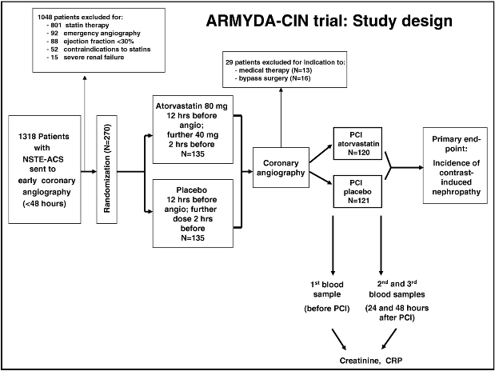
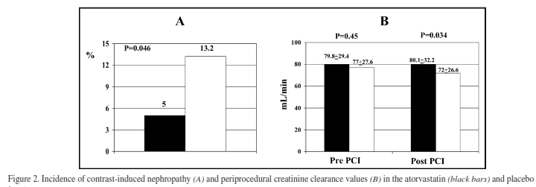
ARMYDA-CIN trial
Patti G et al. Short-term, high-dose Atorvastatin pretreatment to prevent CIN in patients with ACS undergoing PCI (from the ARMYDA-CIN [atorvastatin for reduction of myocardial damage during angioplasty--contrast-induced nephropathy] trial. Am J Cardiol 2011
241 Statin-naive patients with ACS undergoing PCI
Atorvastatin vs placebo
CIN :
  5% vs 13.2% p = 0.046
  OR 0.34, 95% CI 0.12 to 0.97 p = 0.043
Atorvastatin group
  Postprocedure S.Cr 1.06 ± 0.35 vs 1.12 ± 0.27 mg/dl p = 0.01
  Creatinine clearance 80.1 ± 32.2 vs 72.0 ± 26.6 ml/min p = 0.034
  Peak CRP levels post intervention 8.4 ± 10.5 vs 13.1 ± 20.8 mg/l p = 0.01
  Shorter hospital stay p = 0.007

Slide 87
Statins prevent CIN in CKD ?
Toso A et al. Usefulness of atorvastatin (80 mg) in prevention of contrast-induced nephropathy in patients with chronic renal disease. Am J Cardiol 2010
Single-center RCT
304 patients with baseline Cr. Cl <60 ml/min
Atorvastatin 80 mg/day vs placebo (48 hrs before and 48 hrs after)
All received iv saline hydration and oral NAC 1,200 mg BD
CIN :
  10% vs 11% p = 0.86
Mean increase in creatinine :
  0.72 ± 0.26 mg/dl vs 0.59 ± 0.17 p = 0.31
Persistent kidney injury : (1m ↑ from baseline creatinine ≥ 25%)
  31% vs 30% p = 0.58
No benefit over iv hydration and oral NAC in pre-existing CKD

Slide 88
High-dose statin
High-Dose Statin Pretreatment for the Prevention of Contrast-Induced Nephropathy: A Meta-analysis 2011
8 trials
1423 patients
Pooled analyses
Short-term high-dose statin
  ↓ CIN (RR 0.51, 95% CI, 0.34-0.77) P = 0.001
  ↓ 48-hr S.Cr (SMD –0.07 mg/dL; 95% CI, –0.11 to –0.04 mg/dL) P < 0.00001
Subgroup analysis :
  Statin pretreatment: No decrease in CIN in preexisting renal impairment (RR 0.90; 95% CI, 0.49-1.65) P = 0.73

Slide 89
Summary
Conflicting and insufficient data to recommend initiation of statin therapy for the prevention of CIN
Statins merit further study for the prevention of CIN

Slide 90
Ascorbic acid
↓ renal damage in experimental models of ischemic or toxic injury
Spargias K et al. Ascorbic acid prevents contrast-mediated nephropathy in patients with renal dysfunction undergoing CAG or intervention. Circulation 2004
Double-blind, RCT
231 patients with S.Cr ≥ 1.2 mg/dL awaiting CAG/PCI
Ascorbic acid vs placebo
Ascorbic acid : 3 g PO 2 hrs before and 2 g BD X 1d post procedure
CIN
  9% vs 20% OR 0.38; 95% CI 0.17 to 0.85) P=0.02
Mean S.Cr
  placebo group 1.36 ± 0.50 → 1.50 ± 0.54 mg/dL P<0.001
  ascorbic acid group 1.46 ± 0.52 → 1.52 ± 0.64 mg/dL P=0.07

Slide 91
REMEDIAL trial
Briguori C et al. Renal Insufficiency Following Contrast Media Administration Trial (REMEDIAL): a randomized comparison of 3 preventive strategies. Circulation 2007
326 patients with CKD
S.cr ≥ 2.0 mg/dL and/or eGFR < 40 ml/ min/1.73 m²
0.9% saline + NAC vs NaHCO₃ + NAC vs 0.9% saline + ascorbic acid + NAC
The amount of contrast used and risk scores were similar
CIN
  Saline + NAC group : 9.9%
  Bicarbonate + NAC group 1.9% (P=0.019 vs saline + NAC)
  Saline + ascorbic acid + NAC : 10.3% (P=1.00 vs saline + NAC)

Slide 92
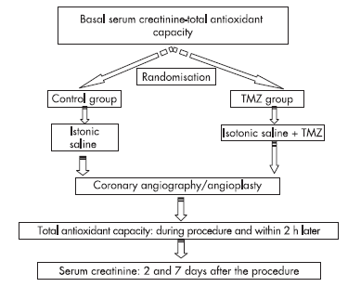
Trimetazidine
Onbasili AO et al. Trimetazidine in the prevention of contrast-induced nephropathy after coronary procedures. Heart 2007
RCT
82 patients
Baseline serum creatinine ≥ 1.2 mg/dl
or eGFR < 50 ml/min
TMZ 20mg TID
NS : 1 ml/kg/hr for 24 h starting
12 h before
CIN
  TMZ group : 2.5% (1/40)
  control group : 16.6% (7/42) (p <0.05)

Slide 93
CARIN study
Coronary Angiography at Risk of Radio-contrast Induced Nephropathy
Prospective, Multi-Center, Double-Blinded, RCT
361 ACS (except STEMI) patients
CMX-2043 : Derivative of alpha lipoic acid
CMX-2043 (3 dosing regimens) vs placebo
Primary Outcome Measures : Prevention of AKI
CIN: 38.2% (placebo) vs 48.2% vs 55.6% (p < 0.01) vs 46.3%

Slide 94
Recommendations
Optimal therapy to prevent CIN remains uncertain
Patients with near-normal renal function are at little risk and few precautions are necessary other than avoidance of volume depletion
High risk patients (S.Cr ≥1.5 mg/dL or an eGFR <60 ml/1.73 m2, DM)
  Grade 1A : Against using high osmolal agents (1400 to 1800 mosmol/kg)
  Grade 1B : Use of iodixanol or nonionic low osmolal agents such as iopamidol or ioversol rather than iohexol
  Use of lower doses of contrast and avoid repetitive, closely spaced studies (eg, <48 hours apart)
  Avoid volume depletion and NSAIDs

Slide 95
Recommendations
Grade 1B : isotonic iv fluids prior to and continued for several hrs after contrast administration
Grade 2B : isotonic bicarbonate rather than isotonic saline
Suggested regimen for isotonic saline :
  1 mL/kg/hr, begun at 6 to 12 hrs prior to the procedure and continuing for 6 to 12 hrs after contrast administration
The duration of fluid administration should be directly proportional to the degree of renal impairment
Grade 2B : NAC be administered the day before and the day of the procedure, based upon its potential for benefit
Grade 2B : 1200 mg orally BD rather than 600 mg BD the day before and the day of the procedure

Slide 96
Recommendations
Grade 2B : suggest not using iv acetylcysteine
Grade 1B : NOT using mannitol or other diuretics prophylactically
Grade 1B : NOT performing prophylactic hemofiltration or hemodialysis in patients with stage 3 and 4 CKD
Grade 2C : prophylactic HD after contrast exposure in patients with stage 5 CKD if there is already a functioning hemodialysis access

Slide 97
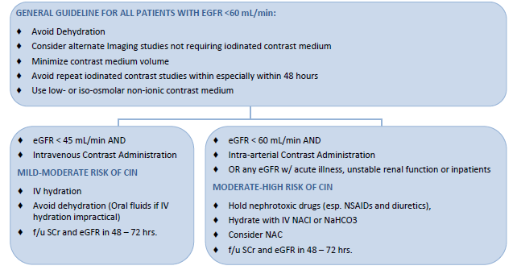
THANK YOU

